Slide 1
Intelligence Meets Vulnerability Management
NYC ISSA
January 24, 2013

Slide 2

Agenda
Introductions & Agenda
Vulnerability Management Today & Tomorrow
CORE Insight Demonstration
2

Slide 3




Is Vulnerability Management Broken?
“The definition of insanity is doing the same thing over and over and expecting different results.”
“Is it time to rethink the vulnerability management hamster wheel?”
“Shouldn’t we focus on Risk & Threats rather than vulnerabilities?”
3
Notes:
Insanity: Doing the same thing over and over again and expecting different results. Albert Einstein (1879 – 1955)

Slide 4

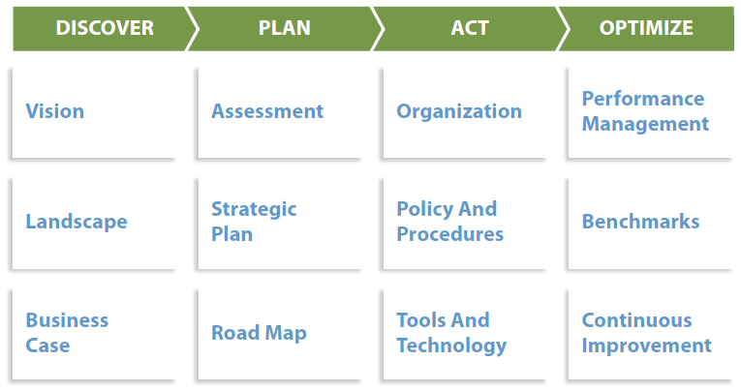
What Needs to Change and Why?
Defend Your Data from Mutating Threats
Security Pro’s Have Yet to Adapt to New Business Models & Threats:
Legacy Networks are Ill-Equipped for a Data-Centric World
Existing Vulnerability Management, Incident Management and Forensic capabilities are insufficient for to detect, prioritize and address modern threats
Security Pro’s Need Situational Awareness and Actionable Intelligence
The Security Architecture and Operations Playbook

Slide 5

What Needs to Change and Why?
Application Security Beyond 2012
Key Findings:
Applications and data are the main focus of modern cyber attacks
Existing identity, endpoint and network security solutions are insufficient for their protection
The changing nature of attacks from “mass” to advanced and targeted, require better technology and skills to detect and deter.
Evolution Vector: Tearing Down Silos, Enabling Mass Security Adoption in 3 Directions
Security Intelligence
Security as a Service
The combination of security, development and operations into a DevOpsSec cycle

Slide 6
Advancing the Vulnerability Management Approach
Vulnerability Validation, Consolidation & Correlation
Threat Modeling, Analysis, & Risk Intelligence
Vulnerability Scanning

Slide 7

Vulnerability Management + Intelligence
All Technical Data –
NO BUSINESS INTELLIGENCE
Vulnerability Overload -
VALIDATION DEMANDING
Dynamic Threat Landscape – MAKES PREDICTING
RISK IMPOSSIBLE
Consolidate
Correlate Multi-Vector Vulnerability Data
Prioritize
Continuously Monitor & Assess Operational Threats
Analyze
Predict Material Risk
Notes:
Traditional VM initiatives have helped organizations identify potential vulnerabilities. But in doing so actually create a new, bigger problem – too much data.
Data overload leads to more work for IT security teams and complicates remediation efforts. Organizations have no way to consolidate, analyze and prioritize what’s real, what’s not, and what to fix
More than 80% of today’s material breaches occur as multi-staged attacks – something traditional vulnerability management systems will rarely detect because most asset relationships behind the firewall are trusted.

Slide 8
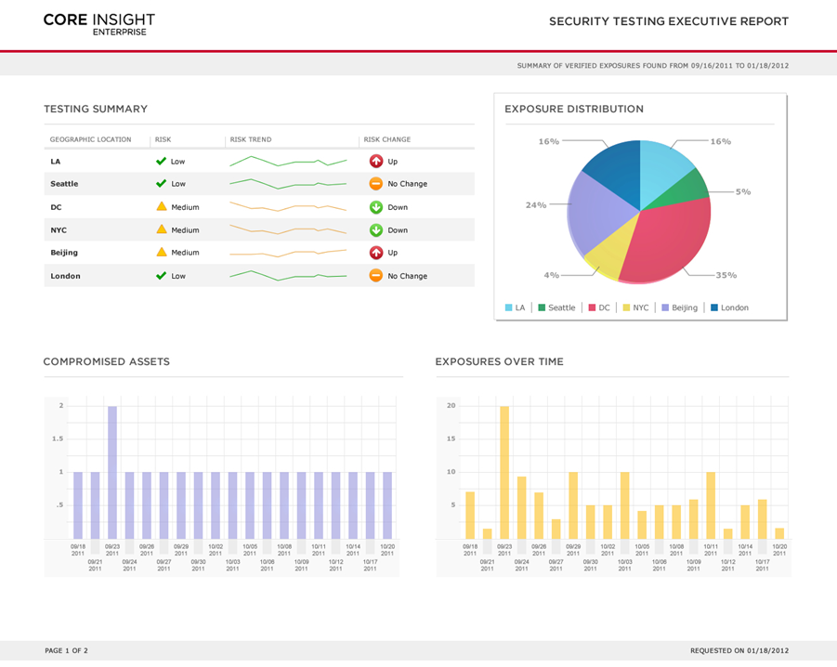
Demonstration

Slide 9
Thank You

