Slide 1
Hacking The Big 4 Databases
Frank Grottola
VP – North American Sales

Slide 2
Agenda
Data, Databases, Data Theft
Database Attack Examples
  Oracle: Stealth Password Cracking
  SQL Server: Escalate a Database Owners Privileges to Sys Admin
  Sybase: Escalate Any User’s Privileges to Sys Admin
  DB2: Create Remote OS Admin Users
Database Security Top 10 Checklist
How to Protect Your Databases with DbProtect
Notes:
We’ll get started with a very quick review of the current state of affairs in the data theft world.
Then we’ll hack some databases. We’re going to hit each of the big 4 today, Oracle, SQL, Sybase, and DB2.
Then we’ll round it all up with a quick review of the top 10 things you should be doing to protect your own databases.

Slide 3


Data, Databases, Data Theft
Over 330,000,000 records stolen in 2011
(DataLossDB)
Over 90% of records stolen from databases (Verizon DBIR)
Too many organizations have failed to take database security seriously.
Notes:
Read the slide

Slide 4
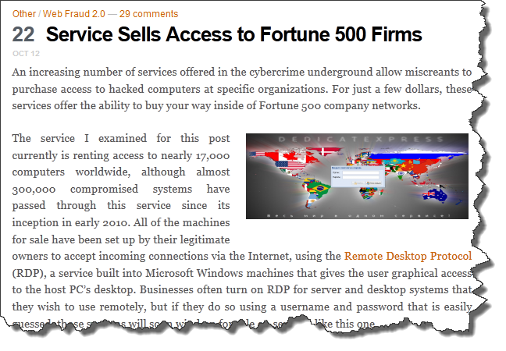
Did You Know?
Notes:
This came from Brian Krebs last week, and it really blew me away. There are online services selling access to compromised systems inside Fortune 500 companies….and it costs as little as $5. You get to remote desktop into the compromised box and do as you please. Now anyone can be an “insider”.

Slide 5
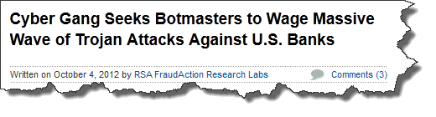
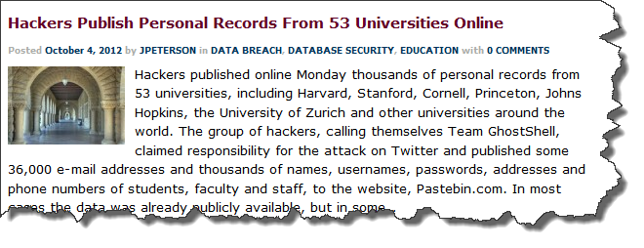



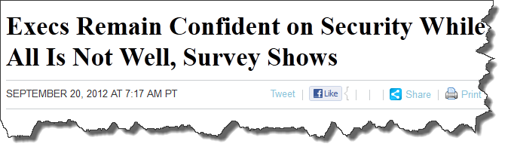
So….Is Anyone Actually Surprised?
Notes:
Lots of breaches keep happening. Read the headlines.
The only people who should be surprised are the Execs that remain confident on security………..

Slide 6
Default and Weak Passwords
Default accounts are never good
Weak passwords can be cracked
Database login activity seldom monitored
Not only DBMS have own default accounts, but applications install them too
Just google “<database type> password cracker” – dozens of them out there
If you’re not watching, an attacker can guess passwords all day
Names, places, dictionary words make poor passwords
Rainbow tables make anything under 7 or 8 characters weak

Slide 7



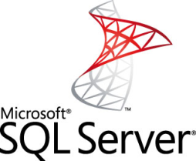


Default Account Examples
User: SA / Password: null
User: sys / Password: change_on_install
User: scott / Password: tiger
User: db2admin / Password: db2admin
User: db2as / Password: ibmdb2
User: SA / Password: null
User: root / Password: null
User: admin / Password: admin
User/Password the Same:
DATABASE SECURITY NOT MY PROBLEM
User/Password the Same:
DBSNMP

Slide 8
Attacking Oracle
Attack Target:
  Oracle 11g Release 2
Privilege Level:
  Any user on the network
Outcome:
  Obtain any user’s password (login as SYS)
Vulnerabilities Exploited:
  Oracle Stealth Password Cracking
Reported by:
  Esteban Martinez Fayo - Team SHATTER - AppSecInc
Patched by Vendor:
  Oct 2012 CPU
Notes:
Let’s attack Oracle.
This is a good one. It’s called Stealth Password Cracking. Oracle themselves ranked this a CVSS 10 – and for Oracle to score a database vulnerability as a 10 is really unheard of.
Stealth Password Cracking is a protocol level attack that exploits a weakness in Oracle’s o11 login protocol. The attack works against Oracle 11g systems (both Release 1 and Release 2), but not against earlier versions of the database. Using this vulnerability, an attacker can get any database user’s password, and then login as that user. Running this exploit requires nothing but a network connection to Oracle. The attack doesn’t cause any failed logins or trip oracle account lockout features. It’s a heck of an exploit.
This one was found by Esteban Martinez Fayo of Team SHATTER. Oracle just patched it earlier this month.

Slide 9
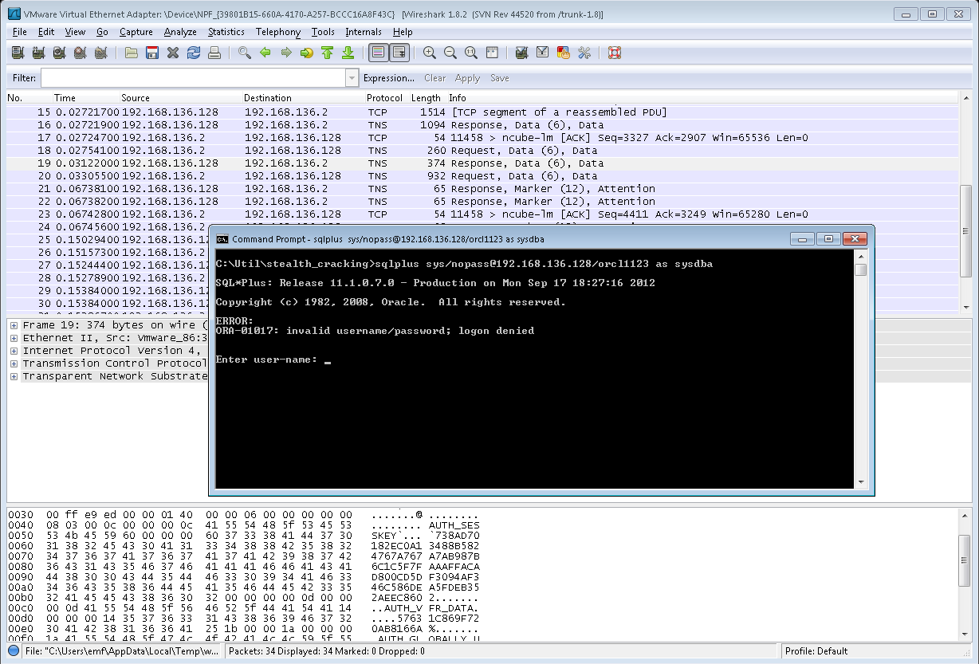
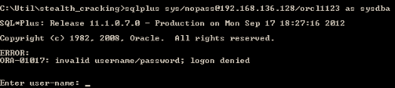
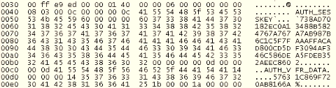
Attacking Oracle: Failed Login + Packet Capture
Notes:
We need to start with some background for this demo to make sense. In Oracle11g, Oracle released a new login protocol called o11. The main reason for adding it was to add case sensitivity to Oracle passwords. If you are wondering, yes, that does mean that in Oracle 10g and earlier versions, database passwords were NOT case sensitive. But Oracle is serious about security. Right?……
The way the new protocol works, the database sends some information to the client as part of the login process. That information can be used to reveal the user’s password.
So, we start by running a packet sniffer to watch the network communication with the database. We’ll need that to find the bit of data we’re looking for. We’re going to use the ubiquitous WireShark for our packet capture needs. That’s what is running in the background.
Now we need to get the authentication data from the database. The easiest way to get this is by attempting to login to the database with a random password. We want to get our hands on a powerful Oracle login, so we’ll go right for the built in system admin account, SYS.
SQLPlus is Oracle’s command line query tool. We’ll use it for our login. We type username / password, then the database info. Remember, we don’t know the password, so let’s just use nopass. Of course the database responds with a failed login. But that’s ok. WireShark has what we want.
Let’s look at the packet capture. We’re looking for these two values, called AUTH_SESSKEY and AUTH_VFR_DATA. You can see them here.
AUTH_SESSKEY is an encrypted encryption key. It’s made up of a key, which looks like random data, padded out using some known values (ending with 8 characters of the value 8). That padded key has then been encrypted. The key used to encrypt it is a hash of the user’s password plus some salt. Salt is just random data.
AUTH_VFR_DATA is the salt that was added to the user’s password before it got hashed and turned into a key.
We have too much information here. We can now guess a password, add the salt that oracle gave us and hash it. Then we can use that value to decrypt the AUTH_SESSKEY. If the resulting data ends with 8 characters of 8’s, we know we started with the right password.
The beauty is that from here forward, everything happens offline. We won’t need to talk to the database again until we have recovered the password and are ready to login.

Slide 10
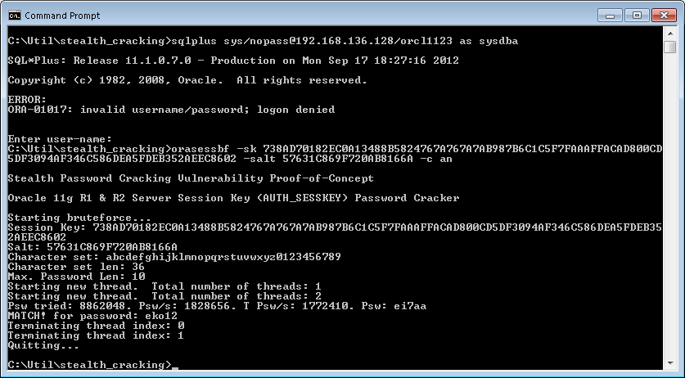
Attacking Oracle: Run Password Brute Force Tool
Notes:
Now we just need to feed the data that wireshark collected into a little script that we wrote, and wait for it to find a working password using brute force. You can see that after 8 million plus attempts, it eventually finds a simple password. Our little script runs at 1.8 million passwords per second, but if you got serious about password cracking, you could obtain speeds several orders of magnitude faster. So I can even break your fancy 8+ character passwords if I’m patient (or wealthy) enough.

Slide 11
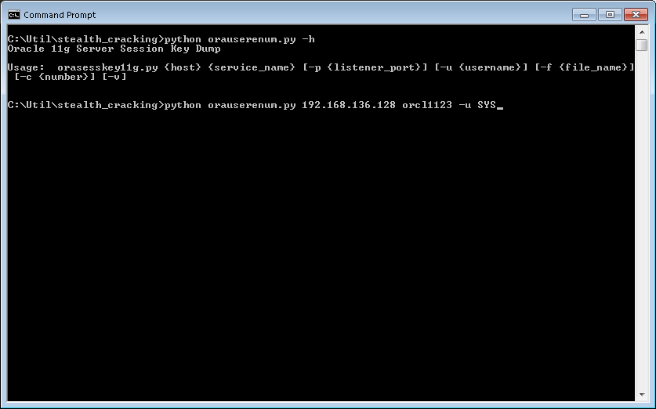
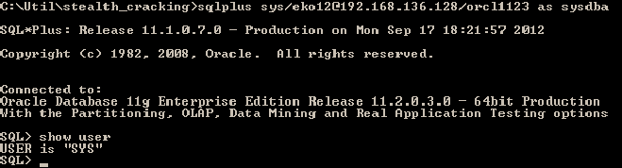
Attacking Oracle: Login As SYS
Notes:
Now that we have the SYS user password, we can use it to login to the database. Oracle confirms the current user is SYS. That’s all it takes folks. SYS owns the whole database, no holds barred.

Slide 12

Attacking Oracle
Notes:
This was supposed to be a photo of larry ellison.

Slide 13
Attacking MS SQL Server: SQL Injection
Attack Target:
  Microsoft SQL Server 2008
Privilege Level:
  CREATE DATABASE
Outcome:
  Full control of SQL Server (become SA)
Vulnerabilities Exploited:
  Privilege escalation via SQL injection in RESTORE function
Reported By:
  Martin Rakhmanov – Team SHATTER – AppSecInc
Patched By Vendor:
  Unpatched
Notes:
13
13
It’s time for our last database attack of the day. Let’s do SQL Server.
This one is actually pretty similar to the attack we ran against Sybase. We’ll escalate our privileges to SA using SQL injection.
Our attack target is SQL 2008. We need a user with CREATE DATABASE privileges to run the exploit.
This vulnerability was discovered by Martin Rakhmanov of Team SHATTER. Microsoft doesn’t think this is a problem, so they’re not going to fix it. You can decide for yourself if you think it’s a vulnerability or not. I sure do.

Slide 14
Attacking Sybase
Attack Target:
  Sybase ASE v15.5
Privilege Level:
  Login only
Outcome:
  Full control of Sybase server (become SA)
Vulnerabilities Exploited:
  Privilege escalation via SQL injection in DBCC IMPORT_METADATA
Reported by:
  Martin Rakhmanov - Team SHATTER - AppSecInc
Patched by Vendor:
  Sybase ASE 15.7 ESD #2 (Sept 2012)
Notes:
On to our first attack. We’ll start with Sybase.
This is Sybase ASE version 15.5. The same attack works on several other Sybase versions.
To execute this attack, we need a user that can login to Sybase. No privileges beyond login are required.
After the exploit, our attacker will have full control of the Sybase database. We’ll do that by giving ourselves the SA (System Administrator) role.
This vulnerability was reported by Martin Rakhmanov of Team SHATTER. Sybase fixed it in September.

Slide 15
Attacking DB2
Attack Target:
  IBM DB2 LUW v9.7 (Windows only)
Privilege Level:
  Login only
Outcome:
  Full control of database and the server it runs on (become OS admin)
Vulnerabilities Exploited:
  Arbitrary Code Execution in SQLJ.DB2_INSTALL_JAR
Reported by:
  Martin Rakhmanov - Team SHATTER - AppSecInc
Patched by Vendor:
  DB2 9.1 FixPack 12 – August 2012
Notes:
Moving on.
Let’s attack big blue – IBM DB2. This time we’ll attack DB2 version 9.7. This attack also works on lots of DB2 versions, including the latest (10.1), but it only works when DB2 is running on Windows. That’s not the most common configuration, but we do see a decent number of these systems out there.
Once again, I only need a user that can login to the database. No privileges required.
I’m going to end up taking full control of DB2 and the Windows box it runs on. I’ll do that by loading and running my own Java code on the database server – using the vulnerable function DB2 INSTALL JAR.
This vulnerability was discovered by Martin Rakhmanov of Team SHATTER. IBM fixed in in August.

Slide 16

Database Security Top 10 Checklist
1: Inventory Databases
2: Tag Critical Systems
3: Change Default Passwords
4: Implement Strong Password Controls
5: Enact and Enforce Patch Management Policies
6: Maintain and Enforce Configuration Standards
7: Document and Enforce Least Privilege Controls
8: Audit Privileged Access
9: Monitor For and Respond To Attacks
10: Encrypt Sensitive Data – At Rest and In Motion
Notes:
Our fun is over. But before you take off, let me leave you with a few tips on what you should be doing to protect your databases. It’s really not that hard, you just have to get over the new technology hump, because beyond the fact that you’re doing these things on a database, they are the same kinds of security stuff you’ve been doing in your environment for ever and ever.
#1 Inventory Databases. You need to know about which databases you have if you’re going to protect them. You may even want to get rid of unauthorized databases that you find.
#2 Tag Critical Systems: You should know which ones of your databases hold the company secrets and which ones hold the softball roster. Then you should treat the important ones to full security coverage.
#3 Change default passwords: Don’t be foolish and leave default passwords in place. They are well documented and leave the system wide open. It’s not just defaults installed with the database, applications install their own default accounts and passwords that you need to change as well.
#4 Implement strong password controls: Most databases have features that help you force users to have strong passwords and to change them regularly. Make sure you enable the features the vendors offer if you want to get any benefit out of them.
#5 Enforce Patch management: There are so many new vulnerabilities being patched by database vendors, and databases don’t patch themselves. DBAs normally only patch when something is broken, so you really need a strategy to make security patching a reality. Otherwise you’ll be 2 years out of date before you know it and wide open to attack.
#6 Maintain Configuration Standards: If you don’t know where you’re going, it’s hard to know when you’ve arrived. You can expect your databases to be configured securely if you don’t have a documented standard that tells everyone what a securely configured database looks like. Once you have a written standard, you need to periodically test your systems for compliance with the standard – at least you need to do the testing if you want the standards to be implemented.
#7 Enforce Least Privilege: It’s much easier to say it than do it, but with so much data lost due to privilege abuse, it’s important to take a hard look at your database privileges to figure out who has access to what. This is a job that can’t be done manually if you want it done right, but there are tools out there to help.
#8 Audit privileged access: Databases come with built-in segregation of duties violations. They’re called DBAs. The only thing you can really do about them is monitor their every move to make sure they don’t abuse the excessive level of access that comes with their jobs. You need to know when they login, when they make changes, and especially when they access business data in the systems they manage.
#9 Monitor and respond to attacks: Today there are a large pool of known database vulnerabilities out there with published exploit code. It’s not hard for an attacker to break into almost any database they want to. You’ve got to be vigilant and watch access to your critical databases 24/7 – particularly if you’re not going to patch them within a few days of every vendor patch release. And if you see any attacks in your monitoring, you need a plan for a speedy and appropriate response.
#10 Encrypt your data: This is the last step. It’s generally easy to turn on network encryption in databases with near zero impact. Encryption of data in the database is a different story, and generally only makes sense when required by industry or government regulations.

Slide 17
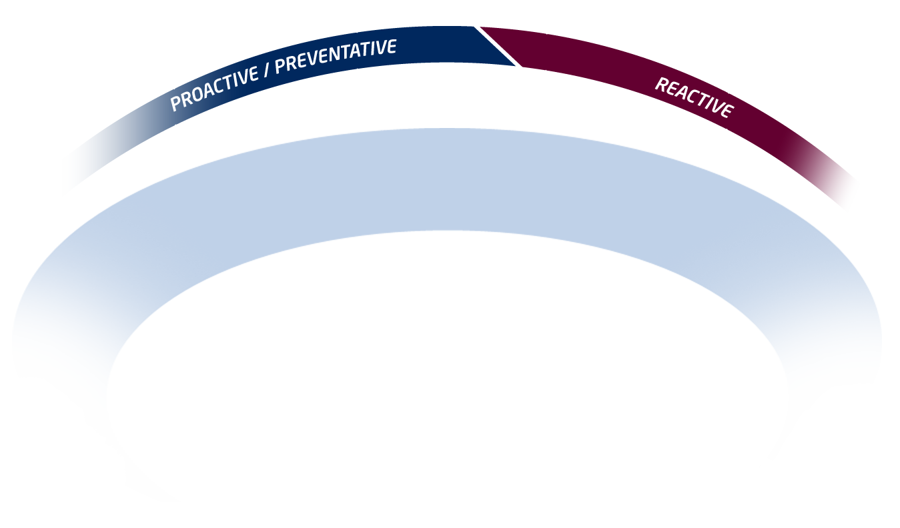



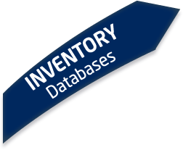



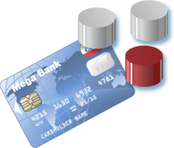


A Process To Secure Your Databases
Precision Security
DbProtect
Notes:
GOAL: Setup the product tour using precision
SCRIPT
- A recent verizon reports stated that 96% of all breaches found were avoidable thru simple controls. This stat supports our precision approach of getting rid of issues before they become issues.
- Elaborating on our Proactive PRECISION approach, our enterprise software platform addresses the 5 critical steps of database security.

Slide 18

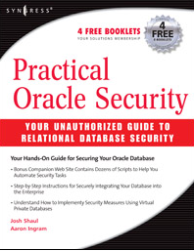
References
Team SHATTER | Security Heuristics of Application Testing Technology for Enterprise Research http://www.teamshatter.com
Top 10 Database Vulnerabilities | http://www.teamshatter.com/topics/general/team-shatter-exclusive/top-10-database-vulnerabilities-and-misconfigurations/
Book | Practical Oracle Security By Josh Shaul CTO, Application Security, Inc.
Josh Shaul
Chief Technology Officer
Application Security, Inc.
Thank you!
Notes:
That’s all folks……….

