Slide 1
When Everyone (Including Your Mother) Is on Facebook: Implications for Information Security & Privacy Professionals
Catherine Dwyer, PhD.
Seidenberg School of Computer Science & Information Systems
Pace University

Slide 2
My talk today
What is a digital native? (everyone)
How did we get here - two tales from the past decade – “MIS” and “Web 2.0”
What challenges does “web 2.0” raise for security and privacy professionals?
How can ISSA and other organizations tackle these issues?

Slide 3
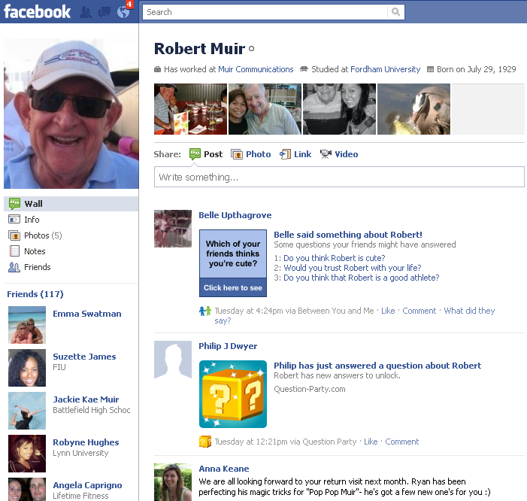

Slide 4
What is a digital native?
Expect immediate access to all information sources relevant to task, available 24/7, from any location, from any “smart” device with an easy to use interface
Always connected, unless they don’t want to be, so you better respect (and protect) their privacy
Traders from investment bank want to be able to execute trades using their iPad

Slide 5
How did we get here? Two stories
“The overinvestment in IT echoes the overinvestment in railroads …. Companies dazzled by the commercial possibilities threw large quantities of money away on half-baked businesses and products.”
2000 - Nasdaq peaks at 5132 (2749 on 5/24)
2002 - SOX is passed
2003 – Carr HBR, “IT Doesn’t Matter”
dot com bust
Outsourcing
Decreased MIS investment and employment
2001 – iPod & iTunes, WikiPedia
2004 – Facebook, GMail (beta)
MIS
Web 2.0

Slide 6
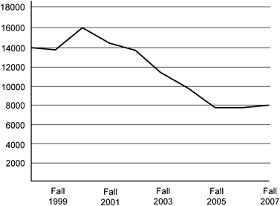
Two Stories cont.
2005 – YouTube, Google Maps
2006 – Twitter
2007 – iPhone
2009 – Android phone
2010 - iPad
US CS Majors
MIS
Web 2.0

Slide 7
2011 – digital natives & IT security professionals
Must manage Web 2.0 security and privacy leaks with strained infrastructure, little training and low staffing levels
Few CS/IS majors graduating – and they are going to work for FB & Google!
Digital natives equals everyone! Customers, employees, and corporate leadership (CEOs with blogs?)
Facebook sets standard for usability and information access
MIS Staff
Digital natives

Slide 8
Oops!
Scott M., VP at HP, updated LinkedIn profile described work developing ‘object storage,’ ‘networking,’ and ‘block storage’ for ‘an innovative and highly differentiated approach to cloud computing.’
The only problem was HP initiative was not public knowledge
Post described user interface, including APIs and language binds for Java, Ruby, etc.

Slide 9
What can we do about it?
Lock down systems: Former national security advisor Richard Clarke reported that after the Pentagon had a security breach from a thumb drive, it ordered that all USB connections plugged with rubber cement
Train people – “if you share information about yourself you could be the victim of identity theft”

Slide 10
Are digital natives aware of data leakage and security issues?
One example from student assignment exercise conducting security/privacy audit:
E.V. has no anti-spyware or anti-virus software
E.V.’s computer does not update its system automatically
E.V. does not use strong passwords, has one password for all of her accounts

Slide 11
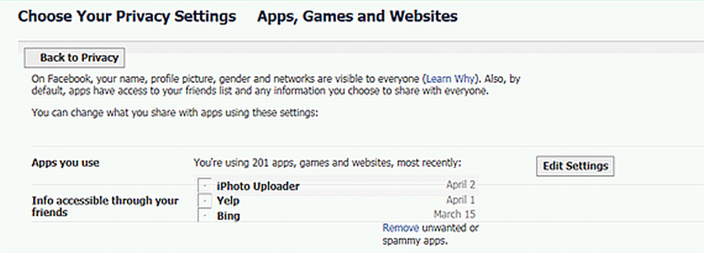
201 Apps!
Facebook Apps are third party applications that get access to profile data (even when FB user is not online)

Slide 12
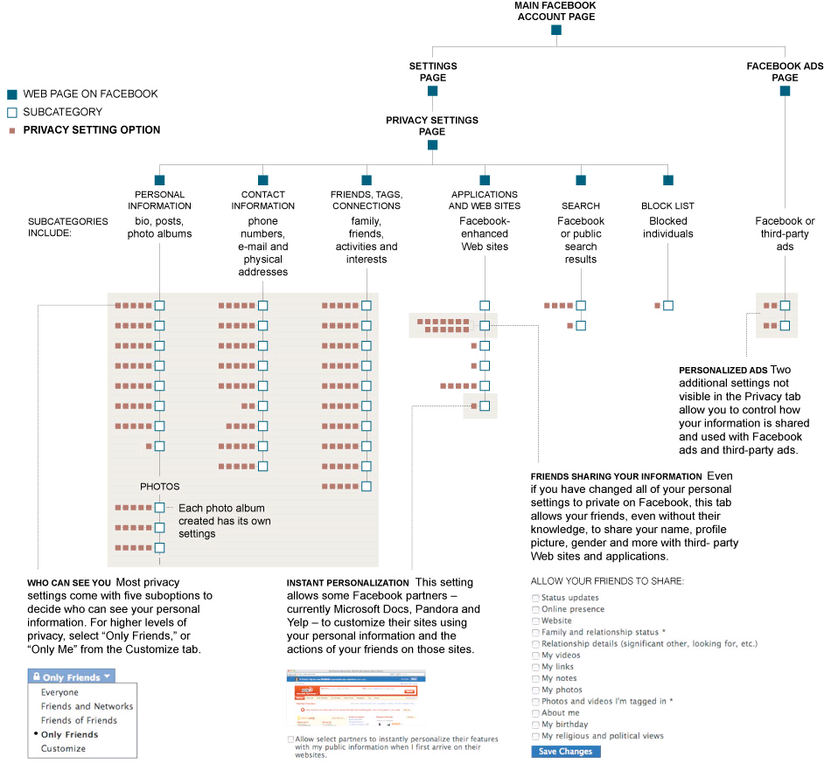
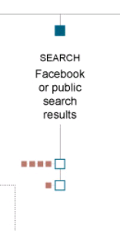
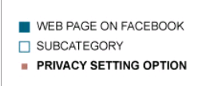
NYT – 5/12/2010
NYT – 5/12/2010 - To manage your privacy on Facebook, you must navigate through 50 settings with more than 170 options

Slide 13
How is privacy implemented?
As a property of data, e.g. social security numbers are private
Must re-conceptualize privacy as a process
“Many argue protecting privacy means strictly limiting access to personal information or assuring people’s right to control information about themselves. I disagree. What people care most about is not simply restricting the flow of information but ensuring that it flows appropriately.” - Helen Nissenbaum, Privacy in Context

Slide 14
Privacy by Design
Building in privacy from the outset achieves better results than “bolting it on” at the end
1) Incorporating four substantive privacy protections into a firm’s practices
Security, collection limits, retention practices, accuracy
2) Maintaining comprehensive data management procedures throughout the life cycle of their products and services

Slide 15
Clear role for ISSA
“Control over privacy” is a data centric approach
Must re-conceptualize privacy as a process, not a property of a distinct piece or category of data
We can’t fix privacy by adding checkboxes to every data sharing decision point
Need to apply BPM, UML and workflow analysis to identify context relevant to information privacy

Slide 16
Going forward
You are critical stakeholders in this process and need a stronger connection to decision makers
Your expertise with COSO framework and COBIT are extremely relevant to these problems – “privacy controls”
Who is your lobbyist?
How can you join the current privacy/security regulatory debate?

Slide 17
Recommended resources
Privacy Papers for Policy Makers (Future of Privacy Forum)
Lessons from the Identity Trail - Lessons From the Identity Trail
Carnegie Mellon - CyLab Harvard - Berkman Center
Stanford - http://cyberlaw.stanford.edu/ NYU - Privacy Research Group
FTC staff report and FCC green paper
Privacy by Design

Slide 18
Questions?
Thank you!
Contact information: Prof. Catherine Dwyer email: cdwyer[at]pace[dot]edu Twitter: ProfCDwyer Diigo bookmarks: profcad
Seidenberg School of Computing Sciences & Information Systems Pace University 163 William Street #225 NY, NY 10038

