Slide 1
Controls Automation and Monitoring
The Benefits of Automated Controls Testing
Amad Fida
President Brinqa
Sep 15, 2010

Slide 2
Agenda
Terminology
Current State
Overview
Proficiencies
Limitations
Future State
Overview
Benefits
Use cases
Summary

Slide 3
Terminology
Controls Automation and Monitoring (CAM)
"Controls automation and monitoring includes any tools that act proactively to implement controls through business rules or reactively to monitor controls through the analysis of processes, transactions and events. Controls automation and monitoring can take many forms and operate at several levels of the enterprise architecture. At the infrastructure level, controls automation and monitoring focus on configuration management and network access. At the system level, they focus on identification and access. At the application level, they focus on SOD and, most recently, on rules governing transactions and behavior." Gartner,
Continuous Controls Monitoring (CCM)
"Within the governance, risk and compliance (GRC) marketplace, continuous controls monitoring (CCM) is a set of technologies that assist the business in reducing business losses from fraud or failure to follow rules governing financial transactions, and improving performance through continuous monitoring (CM) and reducing the cost of auditing through continuous audit (CA) of the automated controls in ERP systems or other financial applications." Gartner,
GRC Platform
A platform that spans enterprise domains to consistently map industry regulations to policies, IT processes, and controls. Direct measurement of controls related to configuration settings, operational metrics, and identity audit information is collected by the GRC platform (CAM) while indirect controls information is consolidated from CAM and CCM tools.

Slide 4
Controls Systems – Current State

Slide 5
Controls – Current State
Current IT-GRC Solutions
SIEM
IAM
Dashboards and Reports
Dashboards/Reports
Compliance Reporting
Regulations
Frameworks
Standards
Controls / Rules
Roles
Policies
Policy Management
Response Engine
Controls
Control Standards
Questions and Assessments
Correlation
Logging
Provisioning Engine
Manual Control Testing
Data Integration
Resource Connectivity
CSV Extracts
Network Devices
Security Devices
Physical Access
Servers
Identity Sources
Databases
Apps

Slide 6
Current State - Proficiencies
IT-GRC Solutions
Program significance established and awareness raised
Centralized content repository for regulations, frameworks, standards, industry mandates, policies, and control standards
Mapping of policies and controls to the regulations, industry mandates, and frameworks they support
Question banks and assessment process jumpstart efforts
Automation of assessment processes
Consistent process for policy management enforced
Point Solutions for CAM (e.g. SIEM, IAM, Vulnerability Scanner, Firewall, etc)
Good for intended purpose
SIEM – provides the best solution for monitoring logs and security events and alerting Security Operations Center (SOC)
IAM – access controls are provisioned, enforced, and audited
Controls put in place
Streamlined compliance in targeted areas, detailed reporting

Slide 7
Current State - Limitations
IT-GRC Solutions
Controls testing is manual, not automated
Lack connecting layer between policies/control definitions and IT resources
Adherence to policy is difficult to track and prove and accountability is difficult to enforce
Limited depth in reporting due to lack of tie in to IT infrastructure
Tracking, auditing, and reporting is complex and often inaccurate
Governance of policies, risk management, and compliance initiatives are not monitored continuously to validate program improvements and ROI
Integration with other point solutions such as SIEM, IAM is difficult, and often not feasible
Point Solutions (CAM & CCM)
Lack context for policies and controls
Reporting views are very narrow in focus and require many disparate dashboards and reporting interfaces
Out-of-the box policy definitions and controls (content) are very limited
Limited connection between solutions and sharing of data

Slide 8
Controls Systems - Future State

Slide 9
Controls – Future State
Dashboards and Reports
Risks
Trends
Metrics
ROI
Compliance
Regulations
Frameworks
Standards
Policy Management
IT-GRC 1.0
IT-GRC 2.0 = CAM + CCM
Control Standards
Questionnaires
Automated Control Testing & Monitoring
Asset Model & Classification
Agent-less Connectors
SIEM
RACF
Antivirus
Firewalls
Servers
Identity Sources
Databases
Apps
IAM

Slide 10
Future State - Benefits
Provide visibility into the effectiveness of disparate controls systems
Increase ROI through re-usable controls and controls framework
Reduce efforts and costs associated with new initiatives
Increased process efficiencies and controls effectiveness
Streamline compliance efforts by mapping regulations with policies and connecting them to the IT controls that ensure adherence
Real-time information using agent-less connectors for proactive controls management
Sustainable and repeatable processes increase data and control quality
Comprehensive dashboards and reporting provide CIO level views of a Company's overall governance, risk and compliance posture with drill down into detailed view

Slide 11
Use Cases

Slide 12
Terminated User Accounts - Requirements
Ensure and Enforce user account termination process
Ensure and Enforce user Access Control Policy controls related to user account termination
Measure and monitor risk associated with terminated user accounts
Comply with SOX requirements related to user account management

Slide 13
Terminated User Accounts - Solution
MAR
SOX
IAM Governance
Production Access Risk
Access Control Policy
Automatic Password Aging
Password Strength
Terminated Accounts Disabled
Create User SOD Checks
Natively
Created User Accounts
Revoke Validation
Asset Model
Agent-less Connectors
Identity Store
IAM
AD

Slide 14
Terminated User Accounts - Solution
Establish connectivity to target systems, i.e. HR, Corporate Directory, and IAM system (if any) to automate control monitoring
Result: direct connection to IT increases reliability of data, effectiveness of controls system
Build asset repository to model the physical environment, data correlation, asset classification and asset relationship
Map connector data to asset key metrics in order to do control testing, trending and historical data reporting
Configure OOB controls that map to policies, objectives, business process, risks, regulation etc.
Configure automated control tests, test frequency and target assets
Monitor controls on a continuous basis, find issues, manage and track and remediate issues
Control harmonization results in test once, report all

Slide 15
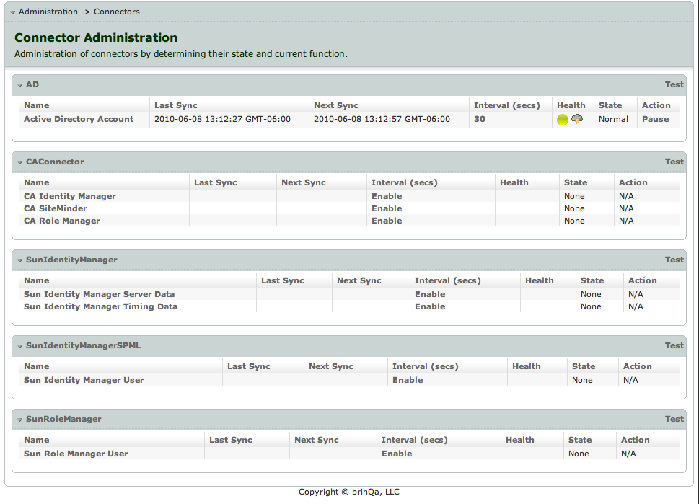
Agent-less Connectivity

Slide 16
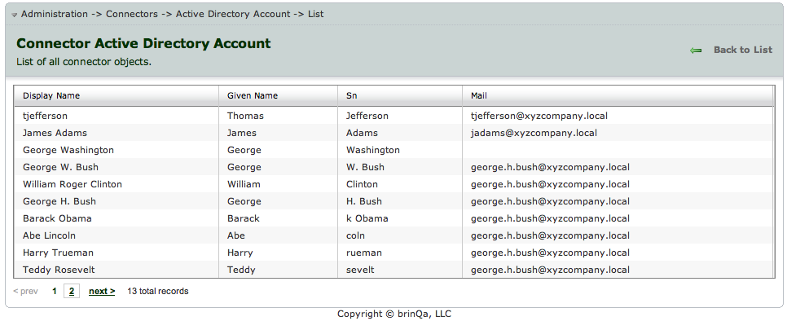
Connector Data

Slide 17
Terminated User Accounts - Solution
Establish connectivity to target systems, i.e. HR, Corporate Directory, and IAM system (if any) to automate control monitoring to increase reliability, efficiency and effectiveness of overall controls system
Build asset repository to model the physical environment, data correlation, asset classification and asset relationship
Result: Consistent and simplified handling of logically grouped assets increases re-usability of controls
Map connector data to asset key metrics in order to do control testing, trending and historical data reporting
Configure OOB controls that map to policies, objectives, business process, risks, regulation etc.
Configure automated control tests, test frequency and target assets
Monitor controls on a continuous bases, find issues, manage and track and remediate issues
Control harmonization results in test once, report all

Slide 18
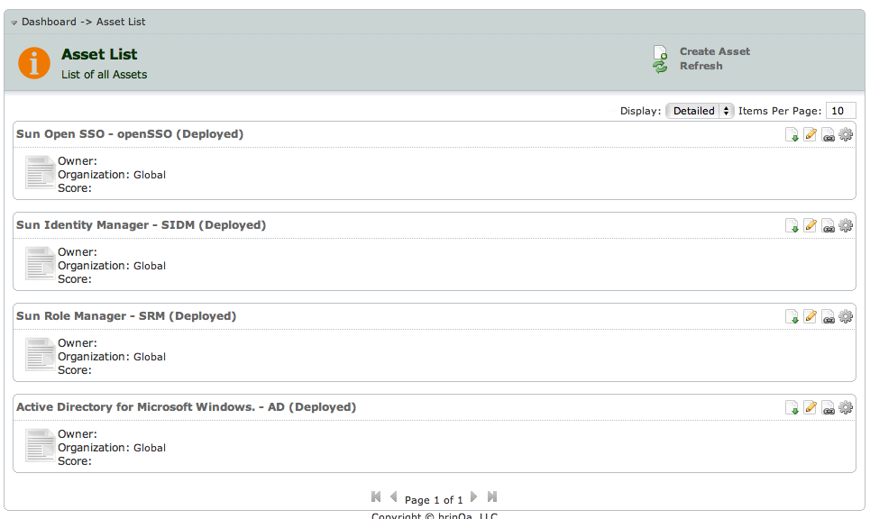
Asset Repository

Slide 19
Terminated User Accounts - Solution
Establish connectivity to target systems, i.e. HR, Corporate Directory, and IAM system (if any) to automate control monitoring to increase reliability, efficiency and effectiveness of overall controls system
Build asset repository to model the physical environment, data correlation, asset classification and asset relationship
Map connector data to asset key metrics in order to do control testing, trending and historical data reporting
Results: identification of issues in real-time, full audit enables comprehensive analysis and views of IT GRC programs
Configure OOB controls that map to policies, objectives, business process, risks, regulation etc.
Configure control tests, test frequency and target assets
Monitor controls on a continuous bases, find issues, manage and track and remediate issues
Control harmonization results in test once, report all

Slide 20
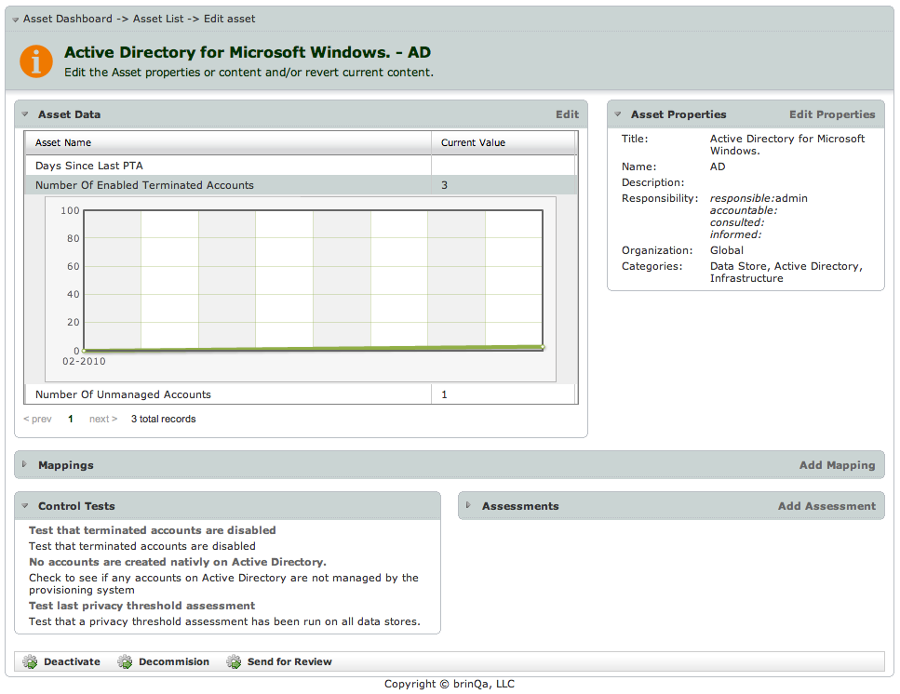
Asset Details

Slide 21
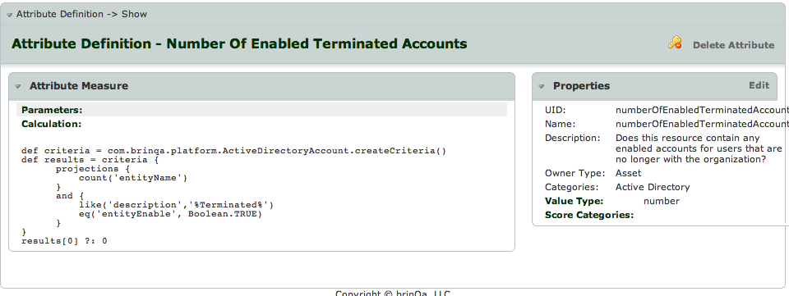
Asset Key Control Metrics

Slide 22
Terminated User Accounts - Solution
Establish connectivity to target systems, i.e. HR, Corporate Directory, and IAM system (if any) to automate control monitoring to increase reliability, efficiency and effectiveness of overall controls system
Build asset repository to model the physical environment, data correlation, asset classification and asset relationship
Map connector data to asset key metrics in order to do control testing, trending and historical data reporting
Configure OOB controls that map to policies, objectives, business process, risks, regulation etc.
Results – Proving compliance with regulations becomes easier, accountability for adherence to policies increases
Configure automated control tests, test frequency and target assets
Monitor controls on a continuous bases, find issues, manage and track and remediate issues
Control harmonization results in test once, report all

Slide 23
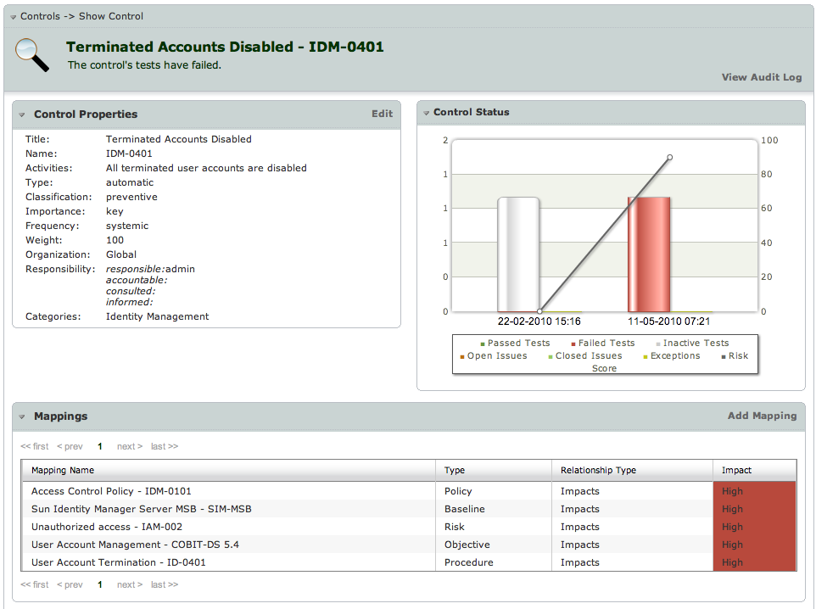
Control Definition

Slide 24
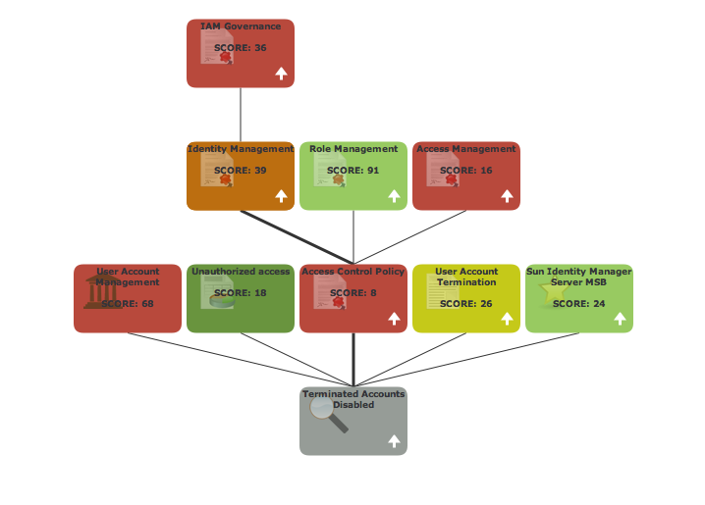
Control Mapping

Slide 25
Terminated User Accounts - Solution
Establish connectivity to target systems, i.e. HR, Corporate Directory, and IAM system (if any) to automate control monitoring to increase reliability, efficiency and effectiveness of overall controls system
Build asset repository to model the physical environment, data correlation, asset classification and asset relationship
Map connector data to asset key metrics in order to do control testing, trending and historical data reporting
Configure OOB controls that map to policies, objectives, business process, risks, regulation etc.
Configure control tests, test frequency and target assets
Results: automation effects fewer human errors and reduces effort
Monitor controls on a continuous bases, find issues, manage and track and remediate issues
Control harmonization results in test once, report all

Slide 26
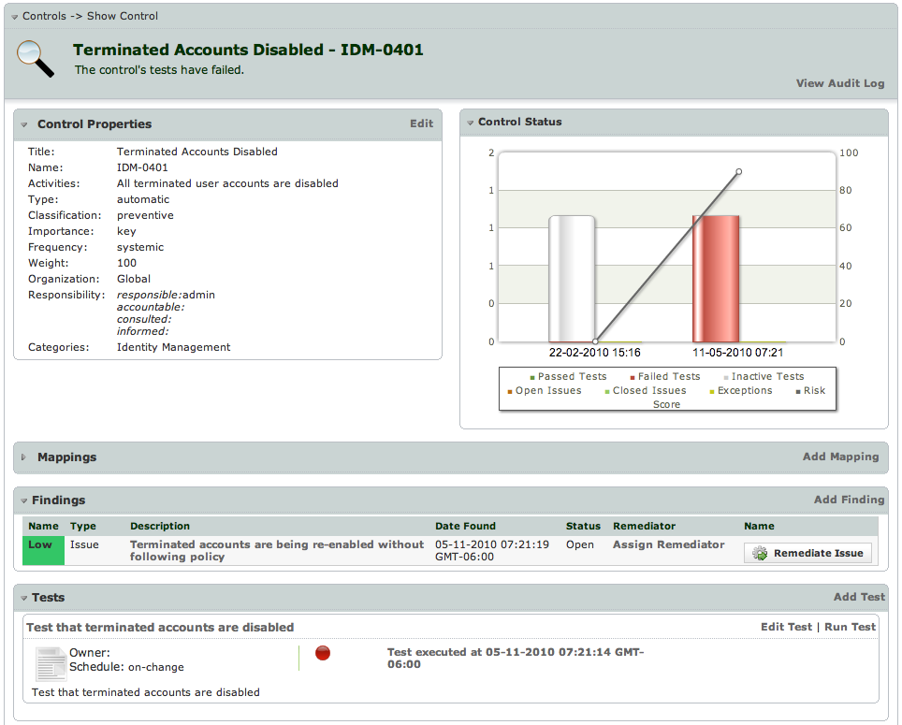
Control Automation and Monitoring

Slide 27
Terminated User Accounts - Solution
Establish connectivity to target systems, i.e. HR, Corporate Directory, and IAM system (if any) to automate control monitoring to increase reliability, efficiency and effectiveness of overall controls system
Build asset repository to model the physical environment, data correlation, asset classification and asset relationship
Map connector data to asset key metrics in order to do control testing, trending and historical data reporting
Identity and choose OOB controls that map to policies, objectives, business process, risks, regulation etc.
Configure automated control tests, test frequency and target assets
Monitor controls on a continuous bases, find issues, manage and track and remediate issues
Results: identification of issues happens quickly and reliably, full audit, remediation plans established quickly and action is ensured
Control harmonization results in test once, report all

Slide 28
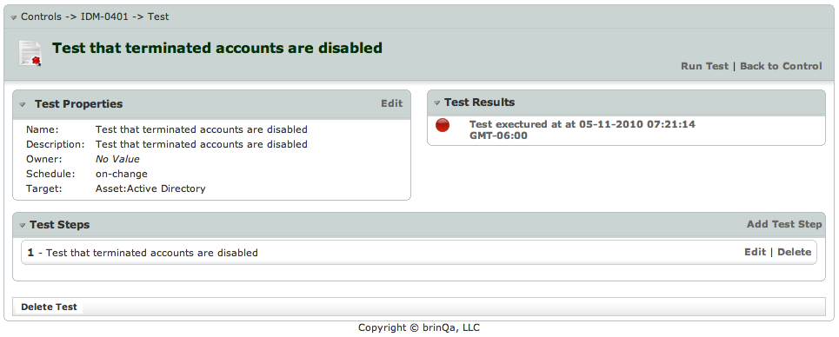
Control Test & Results

Slide 29
Terminated User Accounts - Solution
Establish connectivity to target systems, i.e. HR, Corporate Directory, and IAM system (if any) to automate control monitoring to increase reliability, efficiency and effectiveness of overall controls system
Build asset repository to model the physical environment, data correlation, asset classification and asset relationship
Map connector data to asset key metrics in order to do control testing, trending and historical data reporting
Identity and choose OOB controls that map to policies, objectives, business process, risks, regulation etc.
Configure automated control tests, test frequency and target assets
Monitor controls on a continuous bases, find issues, manage and track and remediate issues
Control harmonization results in test once, report all
Results: dashboards and reports reflect analysis of data from across disparate controls monitoring system in a cohesive way.

Slide 30
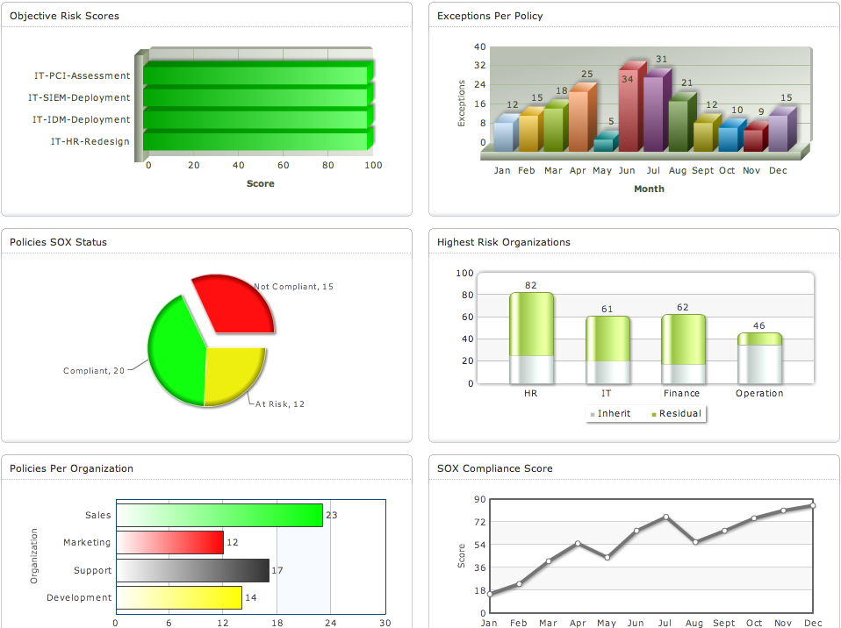
Reports and Dashboards

Slide 31
Summary
Continuous Controls Management (CCM) is a subset of Controls Automation and Monitoring (CAM)
IT-GRC v1.0 solutions provided an important stepping stone towards a comprehensive CAM solution, but lack support for automation of controls
Many point solutions are available for CAM but they are very targeted (not comprehensive!)
IT GRC v2.0 introduces the continuous GRC Platform which leverages disparate CAM solutions and existing policy management/content solutions to provide an encompassing CAM solution (including CCM)
The GRC Platform provides the broad view across your policies and controls mapped into the relevant regulations and frameworks while automating controls management
Automation of controls management simplifies everyone’s life!

